Slide 1
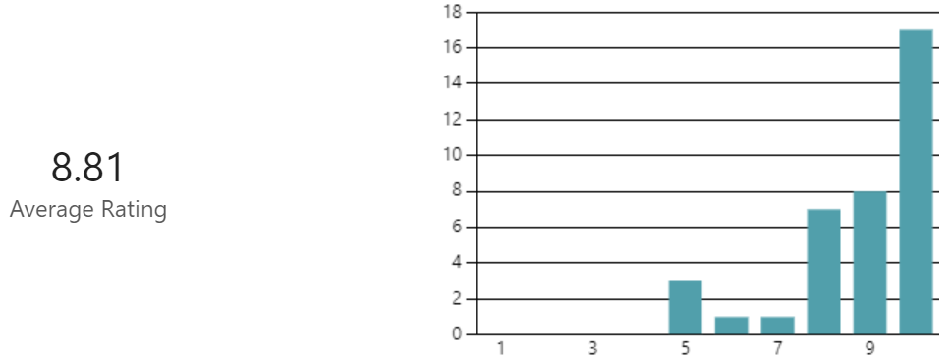
Lakes Estate Renewal Project
Resident Feedback Survey
| September 2024
RESIDENT FEEDBACK SURVEY
The first feedback survey has now closed. This was the first survey of the project and will allow us to benchmark satisfaction.
We will be opening the survey every 6 months to compare results. We will compare between current satisfaction levels and those in 6 months, 1 year and 18 months.
The results for benchmarking are as below:
The GRAHAM Project Team has multiple ways of communicating with residents/stakeholders/partners, including:
Newsletters
Microsite
Email correspondence
Notice boards
Attendance at partnership meetings
Other in-person events
Face-to-face at the site office/around the estate
Do these methods of communication work for you or your organisation?
How satisfied are you with the methods of communication (with 10 being ‘Extremely Satisfied’ and 1 being ‘Not Satisfied’)?
Is the information that the GRAHAM Project Team sends you or your organisation clear and easy to understand?

Slide 2
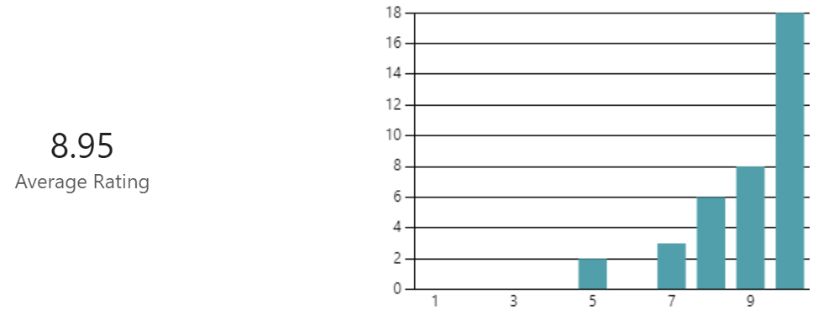
How satisfied are you with the information being sent (with 10 being ‘Extremely Satisfied’ and 1 being ‘Not Satisfied’)?
Have you or your organisation ever contacted the GRAHAM Project Team with an enquiry?
In general the summarised feedback is that residents are happy with the communications received from GRAHAM regarding the project, and quite a few commented on how helpful and polite GRAHAM staff and employees are, and enquiries are dealt with in a quickly and efficiently
How satisfied are you with the level of service (with 10 being ‘Extremely Satisfied’ and 1 being ‘Not Satisfied’)?
The general consensus is that the level of service is far exceeding expectation, which is lovely to hear. There were some comments regarding the upkeep of the estate, which have been dealt with. There were some issues with traffic management and areas of the estate that needed attention, all of which have been shared with the relevant authorities.
​
Thank you to those of you who took the time to complete questionnaires. We would hope to have a higher proportion of residents complete next time.
As always, please do come to us straight away with any issues so that we can endeavour to resolve as soon as practically possible. Email Samantha Key at buildingsouthcustomerrelations@graham.co.uk or call 07391 185430.

